Slide 1

Developing a Strategic Legal Preparation Tool
Author: Sindhuja Subramanian
Date: 08-03-2025

Slide 2
CONTENTS
1. Overview of the Application
2. Code Breakdown
3. Web Interface
4. Running the Application
5. Conclusion

Slide 3
1. Overview of the Application

Slide 4

Overview of the Application
Objectives of the Application
Technological Framework Employed
• The application utilizes advanced technologies such as PyMuPDF for text extraction from PDFs, and Ollama's Mistral model for natural language processing and legal argument extraction, ensuring reliability and effectiveness.
• Systematically extract and categorize arguments both supporting and opposing specific topics presented within the text, facilitating a balanced view.
• Flask serves as the robust web framework, providing a solid foundation for application development.
• PDFMiner is utilized for efficient extraction of text from PDF files, ensuring accurate data retrieval.
• SpaCy is employed for various Natural Language Processing tasks, enhancing the application's linguistic capabilities.
• Transformers are leveraged for advanced summarization and classification tasks, significantly improving content analysis.

Slide 5
Application Architecture Overview
File Organization Framework
• uploads/: This directory serves as a dedicated space for securely storing all uploaded PDF files, ensuring easy access and management.
• app.py: This is the core application file that encapsulates the entire Flask application, including essential routing and business logic.
• templates/: A structured directory that houses all HTML templates, facilitating the rendering of dynamic web pages.

Slide 6
2. Code Breakdown

Slide 7
Setting Up a Flask Application
Library Importation for Project
Flask Application Initialization
• Import the Flask framework components: Flask, render_template, request, and jsonify for web functionalities.
• Utilize the os module for operating system interactions.
• Integrate pdfminer.high_level for PDF processing capabilities.
• Employ spacy for advanced natural language processing tasks.
• Use transformers library to leverage pre-trained models for various NLP applications.
• Instantiate the Flask application by creating an app object, which serves as the core of the web application.
• Specify the directory for file uploads and implement a check to confirm that this directory is present, creating it if necessary.

Slide 8
NLP Model Loading
Loading Models
• Load SpaCy model for entity recognition.
• Load summarization and classification models from Transformers.

Slide 9
PDF Text Extraction
Function: extract_text_with_page_numbersextract_text_with_page_numbers
• Extracts text from a PDF with page-wise references.
• Returns a dictionary with page numbers as keys.

Slide 10
Argument Classification
Function: classify_argumentclassify_argument
• Classifies sentences as supporting or opposing using Natural Language Inference (NLI).
• Returns classification based on confidence threshold.

Slide 11
Text Analysis
Function: analyze_text_with_page_numbersanalyze_text_with_page_numbers
• Analyzes text and extracts arguments with page references.
• Summarizes text and classifies arguments.
• Returns summaries, key entities, and top arguments for both sides.

Slide 12
3. Web Interface

Slide 13

HTML Document Framework
Primary HTML Framework Design
Cascading Style Sheets Design
• The foundational layout utilizes Bootstrap, ensuring responsive design and modern aesthetics.
• Includes a dedicated form for users to upload PDF files, enhancing functionality and user interaction.
• Tailored CSS rules are implemented to refine the application’s layout and enhance the visual appeal of various elements.

Slide 14
JavaScript Core Functionalities
Managing File Upload Processes
Presenting Analysis Results
• Implement an event listener that triggers when a file is selected, effectively displaying the chosen file name to the user for confirmation.
• Utilize an AJAX request to seamlessly upload the selected file to the server, while also retrieving the analysis results in real-time for immediate feedback.
• The result table is dynamically refreshed to include a comprehensive list of arguments both supporting and opposing the findings from the analysis, ensuring clarity and thorough understanding.

Slide 15
4. Running the Application

Slide 16


4. Executing the Application
Initiating the Flask Server Instance
Navigating to the Application Interface
• Use the specific command to launch the application in debug mode, allowing for real-time error tracking and code updates.
• Detailed guidelines on accessing the web interface through a web browser, ensuring users can interact with the application seamlessly.

Slide 17
5. Conclusion

Slide 18
5. Final Thoughts
Overview of Key Features
Prospective Enhancements
• Comprehensive capabilities including PDF text extraction, precise argument classification, and effective summarization techniques.
• Intuitive and user-friendly web interface designed to facilitate seamless interaction for users of all skill levels.
• Identifying and implementing potential enhancements aimed at significantly improving both accuracy and overall user experience in future iterations.

Slide 19
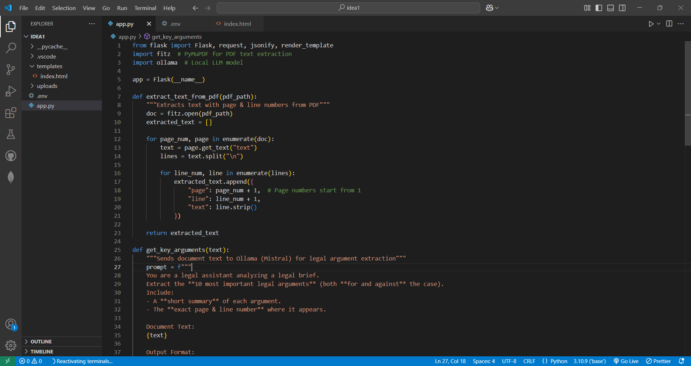
Code Snippets :

Slide 20
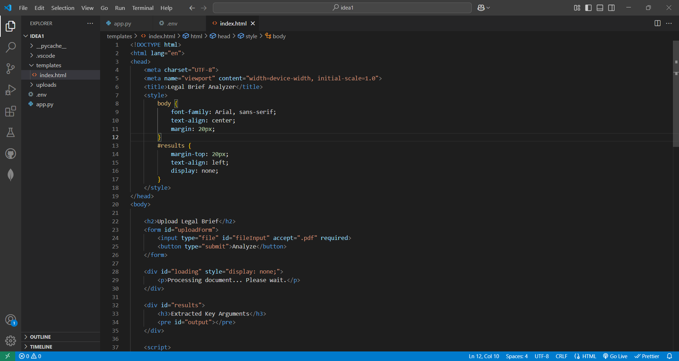
Code Snippets :

Slide 21
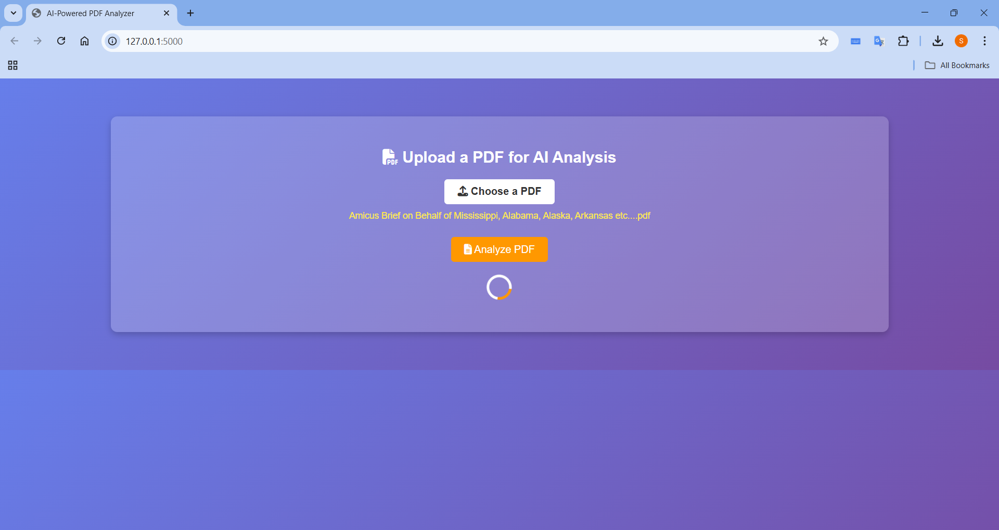
Code Snippets :

Slide 22
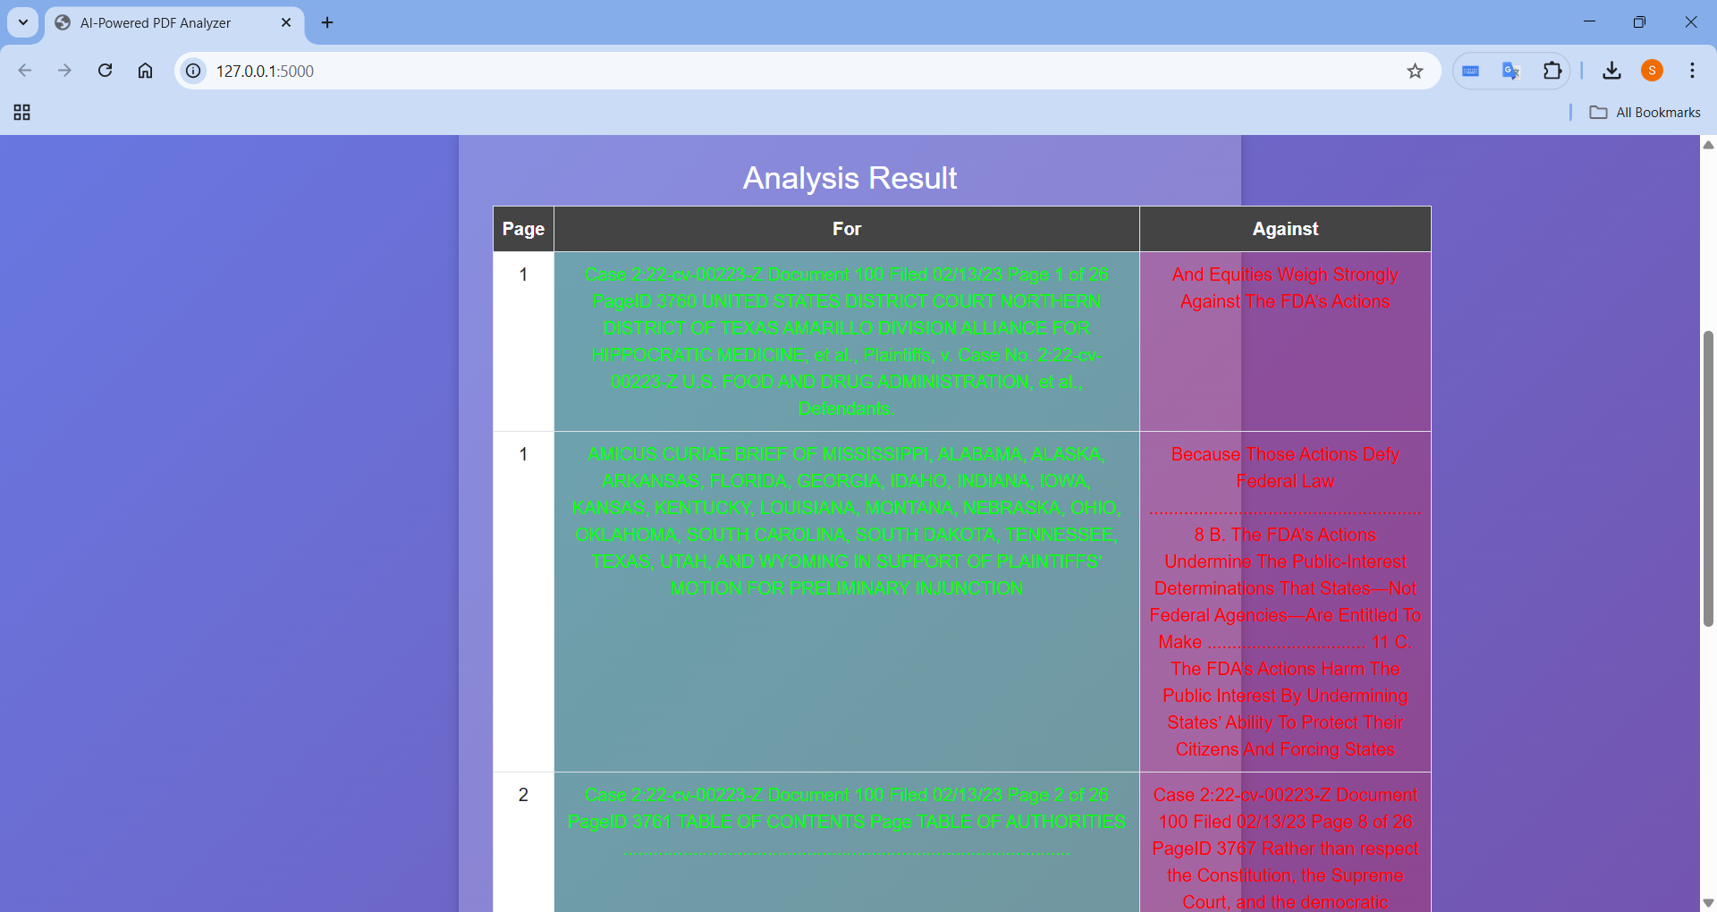
Code Snippets :

Slide 23
Thank You

